Slide 1

MPI
Sapna Arora
Assistant Professor
PIET(ECE)

Slide 2
Branch Instructions of
8086

Slide 3
Branch Instructions
These instructions cause change in the sequence of the execution of instruction.
This change can be through a condition or sometimes unconditional.
The conditions are represented by flags
Branch Instructions in 8086 are JUMP,CALL ,RET,LOOP

Slide 4
JUMP
Jump Instructions are used for changing the flow of execution of instructions in the processor. If we want jump to any instruction in between the code, then this can be achieved by these instructions. There are two types of Jump instructions:
Unconditional Jump Instructions
Conditional Jump Instructions

Slide 5
JMP Des:
These instructions are used to jump on a particular location unconditionally, i.e. there is no need to satisfy any condition for the jump to take place.
E.g JMP 2000H

Slide 6
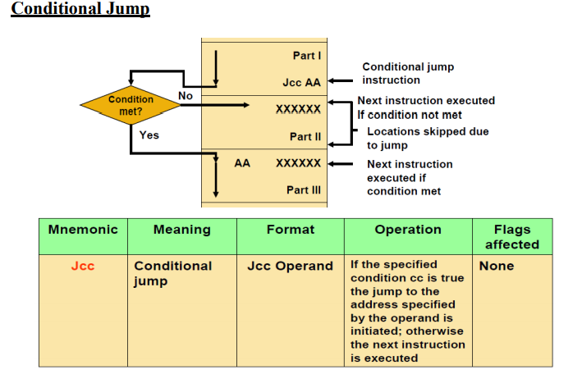

Slide 7
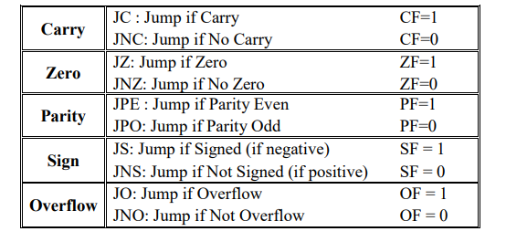
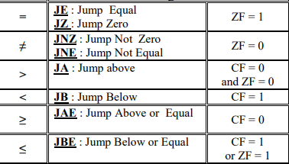
Conditional Jump Instructions

Slide 8
Ex: Write a piece of code that transfers a block of 256 bytes stored at locations starting at 34000H to locations starting at 36000H

Slide 9
MOV AX , 3000H
MOV DS , AX
MOV BX , 0000H
MOV CX , 100H
NEXT: MOV AL , [BX + 4000H]
MOV [BX + 6000H] , AL
INC BX
DEC CX
JNZ NEXT
HLT
Ex : Write an ALP that adds an array of integers of size 256 byte stored at locations starting at 54000H with another array starting at address 56000H, store the result at locations starting at 58000H.
Example: Write an ALP to find the average of an array of size 256 bytes of unsigned integers starting at 6A000H.

Slide 10
Loop Des:
The Loop instruction decrements CX without changing any flags
If CX is not zero after the decrement, control is transferred to the destination label

Slide 11
LOOPZ/LOOPE and LOOPNZ/LOOPNE Instructions
In these two additional instructions, the state of the ZERO Flag may also cause loop termination in addition to the content of the CX register.
Some action inside the loop should affect the zero flag (e.g. a CMP instruction) before these instructions are executed.
LOOPZ/LOOPE: Loop while (ZF = 1) && ( CX not equal to zero)
LOOPNZ/LOOPNE: Loop while (ZF = 0) && (CX not equal to zero)

Slide 12
Example: Write an ALP to find the maximum byte from a block of 256 bytes starting at 53000H.
Ans. MOV AX , 5000H
MOV DS , AX
LEA SI , [3000H]
MOV CX , 0100H
MOV AH , 00H
AGAIN: CMP AH , [SI]
JAE NEXT
MOV AH , [SI]
NEXT: INC SI
LOOPNE AGAIN
MOV [SI] , AH
HLT

Slide 13
CALL (CALL A PROCEDURE) The CALL instruction is used to transfer execution to a subprogram or a procedure. There two basic type of calls near and far.
A near call is a call to a procedure, which is in the same code segment as the CALL instruction.
When the 8086 executes a near CALL instruction, it decrements the stack pointer by 2 and copies the offset of the next instruction after the CALL into the stack.
This offset saved in the stack is referred to as the return address, because this is the address that execution will return to after the procedure is executed.
A near CALL instruction will also load the instruction pointer with the offset of the first instruction in the procedure.
A RET instruction at the end of the procedure will return execution to the offset saved on the stack which is copied back to IP

Slide 14
A far call is a call to a procedure, which is in a different segment from the one that contains the CALL instruction.
When the 8086 executes a far call, it decrements the stack pointer by 2 and copies the content of the CS register to the stack.
It then decrements the stack pointer by 2 again and copies the offset of the instruction after the CALL instruction to the stack.
Finally, it loads CS with the segment base of the segment that contains the procedure, and loads IP with the offset of the first instruction of the procedure in that segment.
A RET instruction at the end of the procedure will return execution to the next instruction after the CALL by restoring the saved values of CS and IP from the stack

